Slide 1
Classifying red wine quality
Ashani Haynes
Regis university

Slide 2
introduction
The purpose of this project is to create and test a variety of classification models and decide which would work best in determining red wine quality.
Types of Classification Models:
Decision Tree
K-fold Cross Validation
Random Forest

Slide 3
The data
Dataset was collected from the UCI Machine Learning Repository via Kaggle
Dataset includes 12 columns and 1599 rows. The 12 columns include: fixed acidity, volatile acidity, citric acidity, residual sugar, chlorides, free sulfur dioxide, total sulfur dioxide, density, pH, sulphates, alcohol and quality (quality being a response variable)
Notes:
https://www.kaggle.com/uciml/red-wine-quality-cortez-et-al-2009/downloads/red-wine-quality-cortez-et-al-2009.zip/2
https://jstevenr.com/wine-classification.html#decision_tree

Slide 4
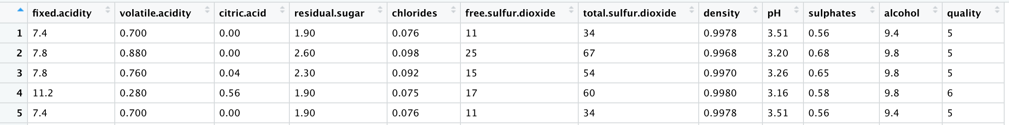
The data

Slide 5
Data cleaning
There were no missing values nor invalid integers
Removal of highly correlated variables
Scaling of all remaining columns
Converting the quality variable into a binary factor
Removal of the quality variable

Slide 6
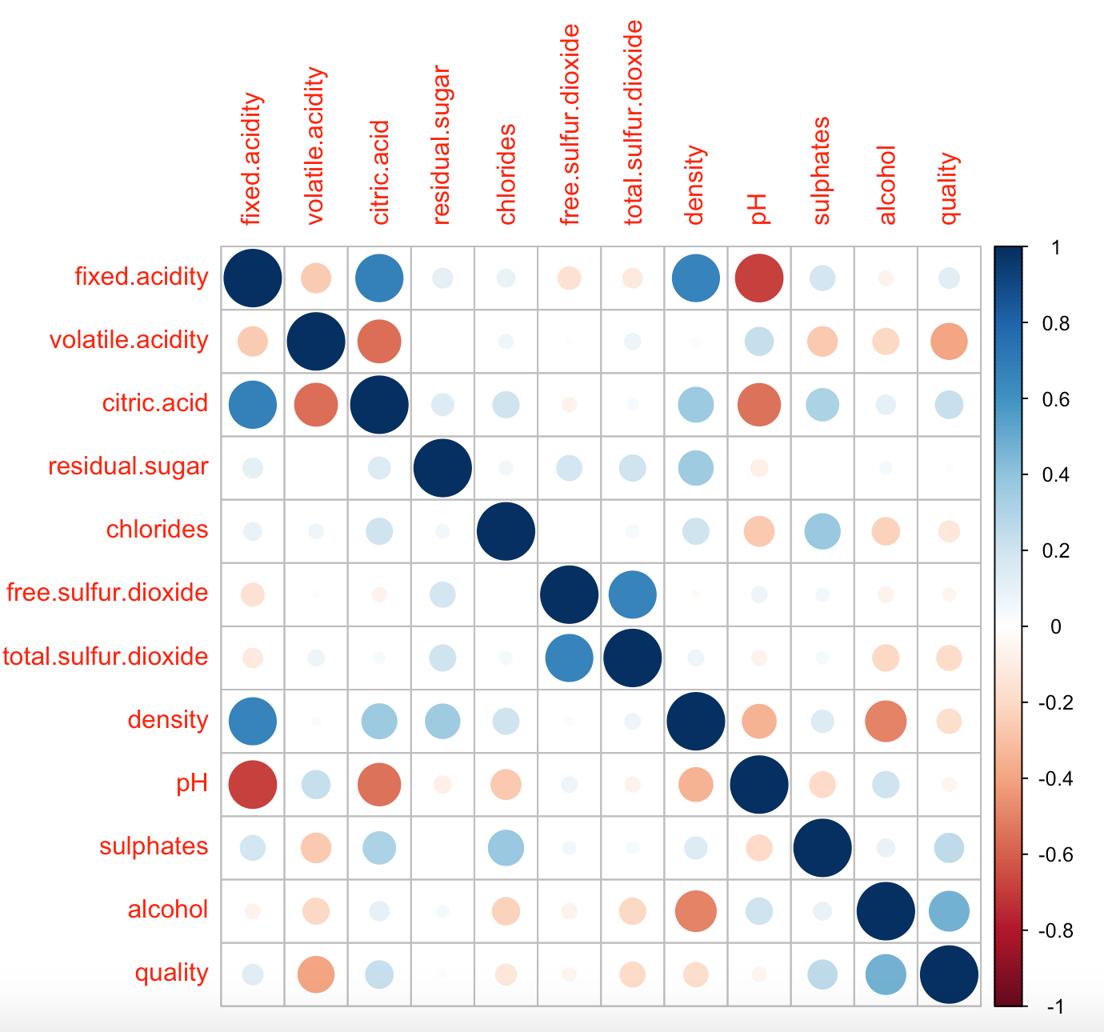
Removing highly correlated variables

Slide 7
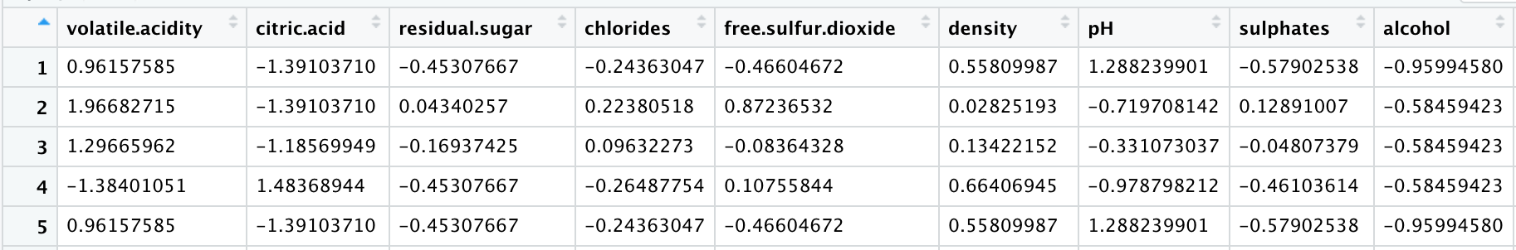
Scaling of remaining attributes

Slide 8
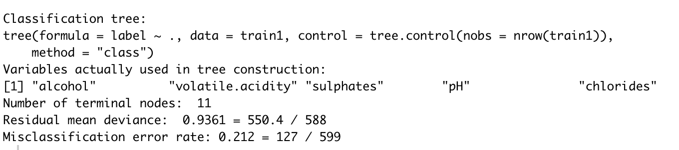
Decision tree

Slide 9
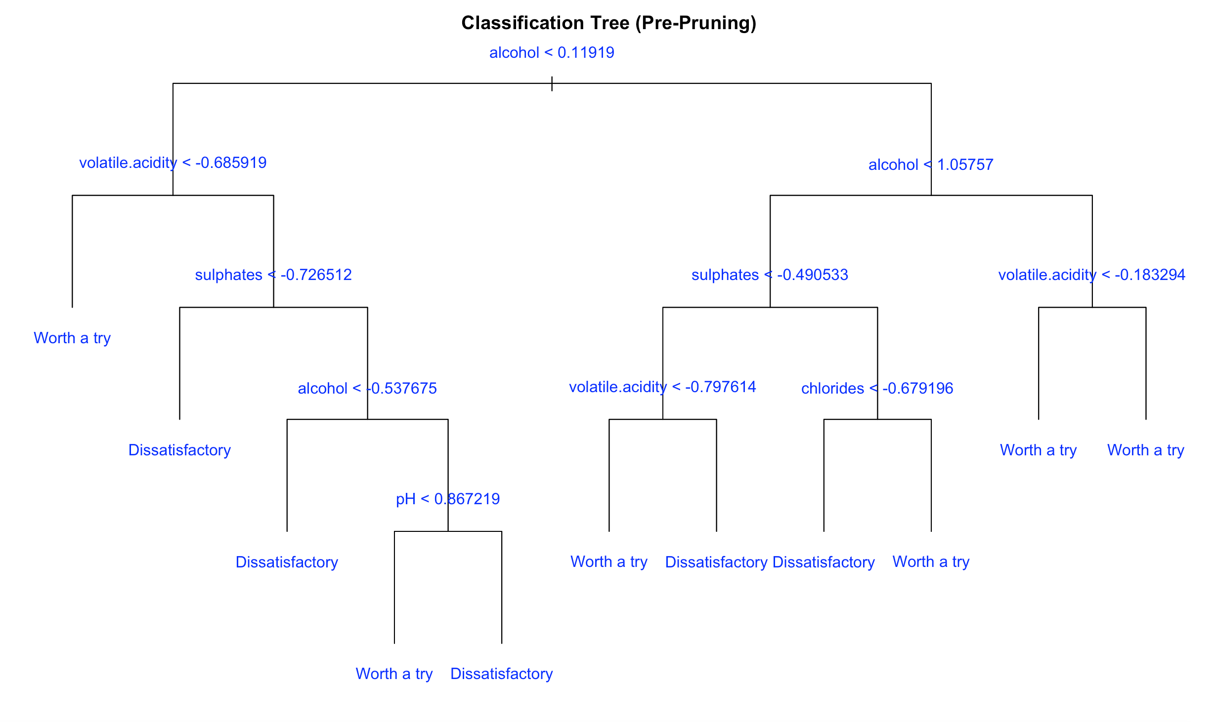
Decision tree (cont’d)

Slide 10
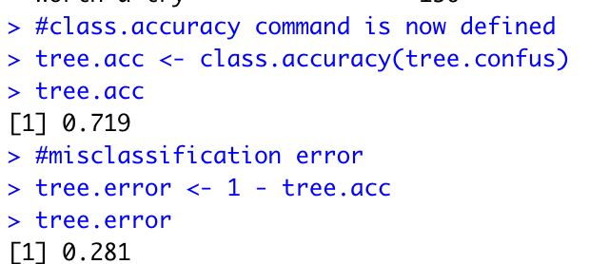
Decision tree (cont’d)
Accuracy rate of tree: 0.719
Error rate of tree: 0.281

Slide 11
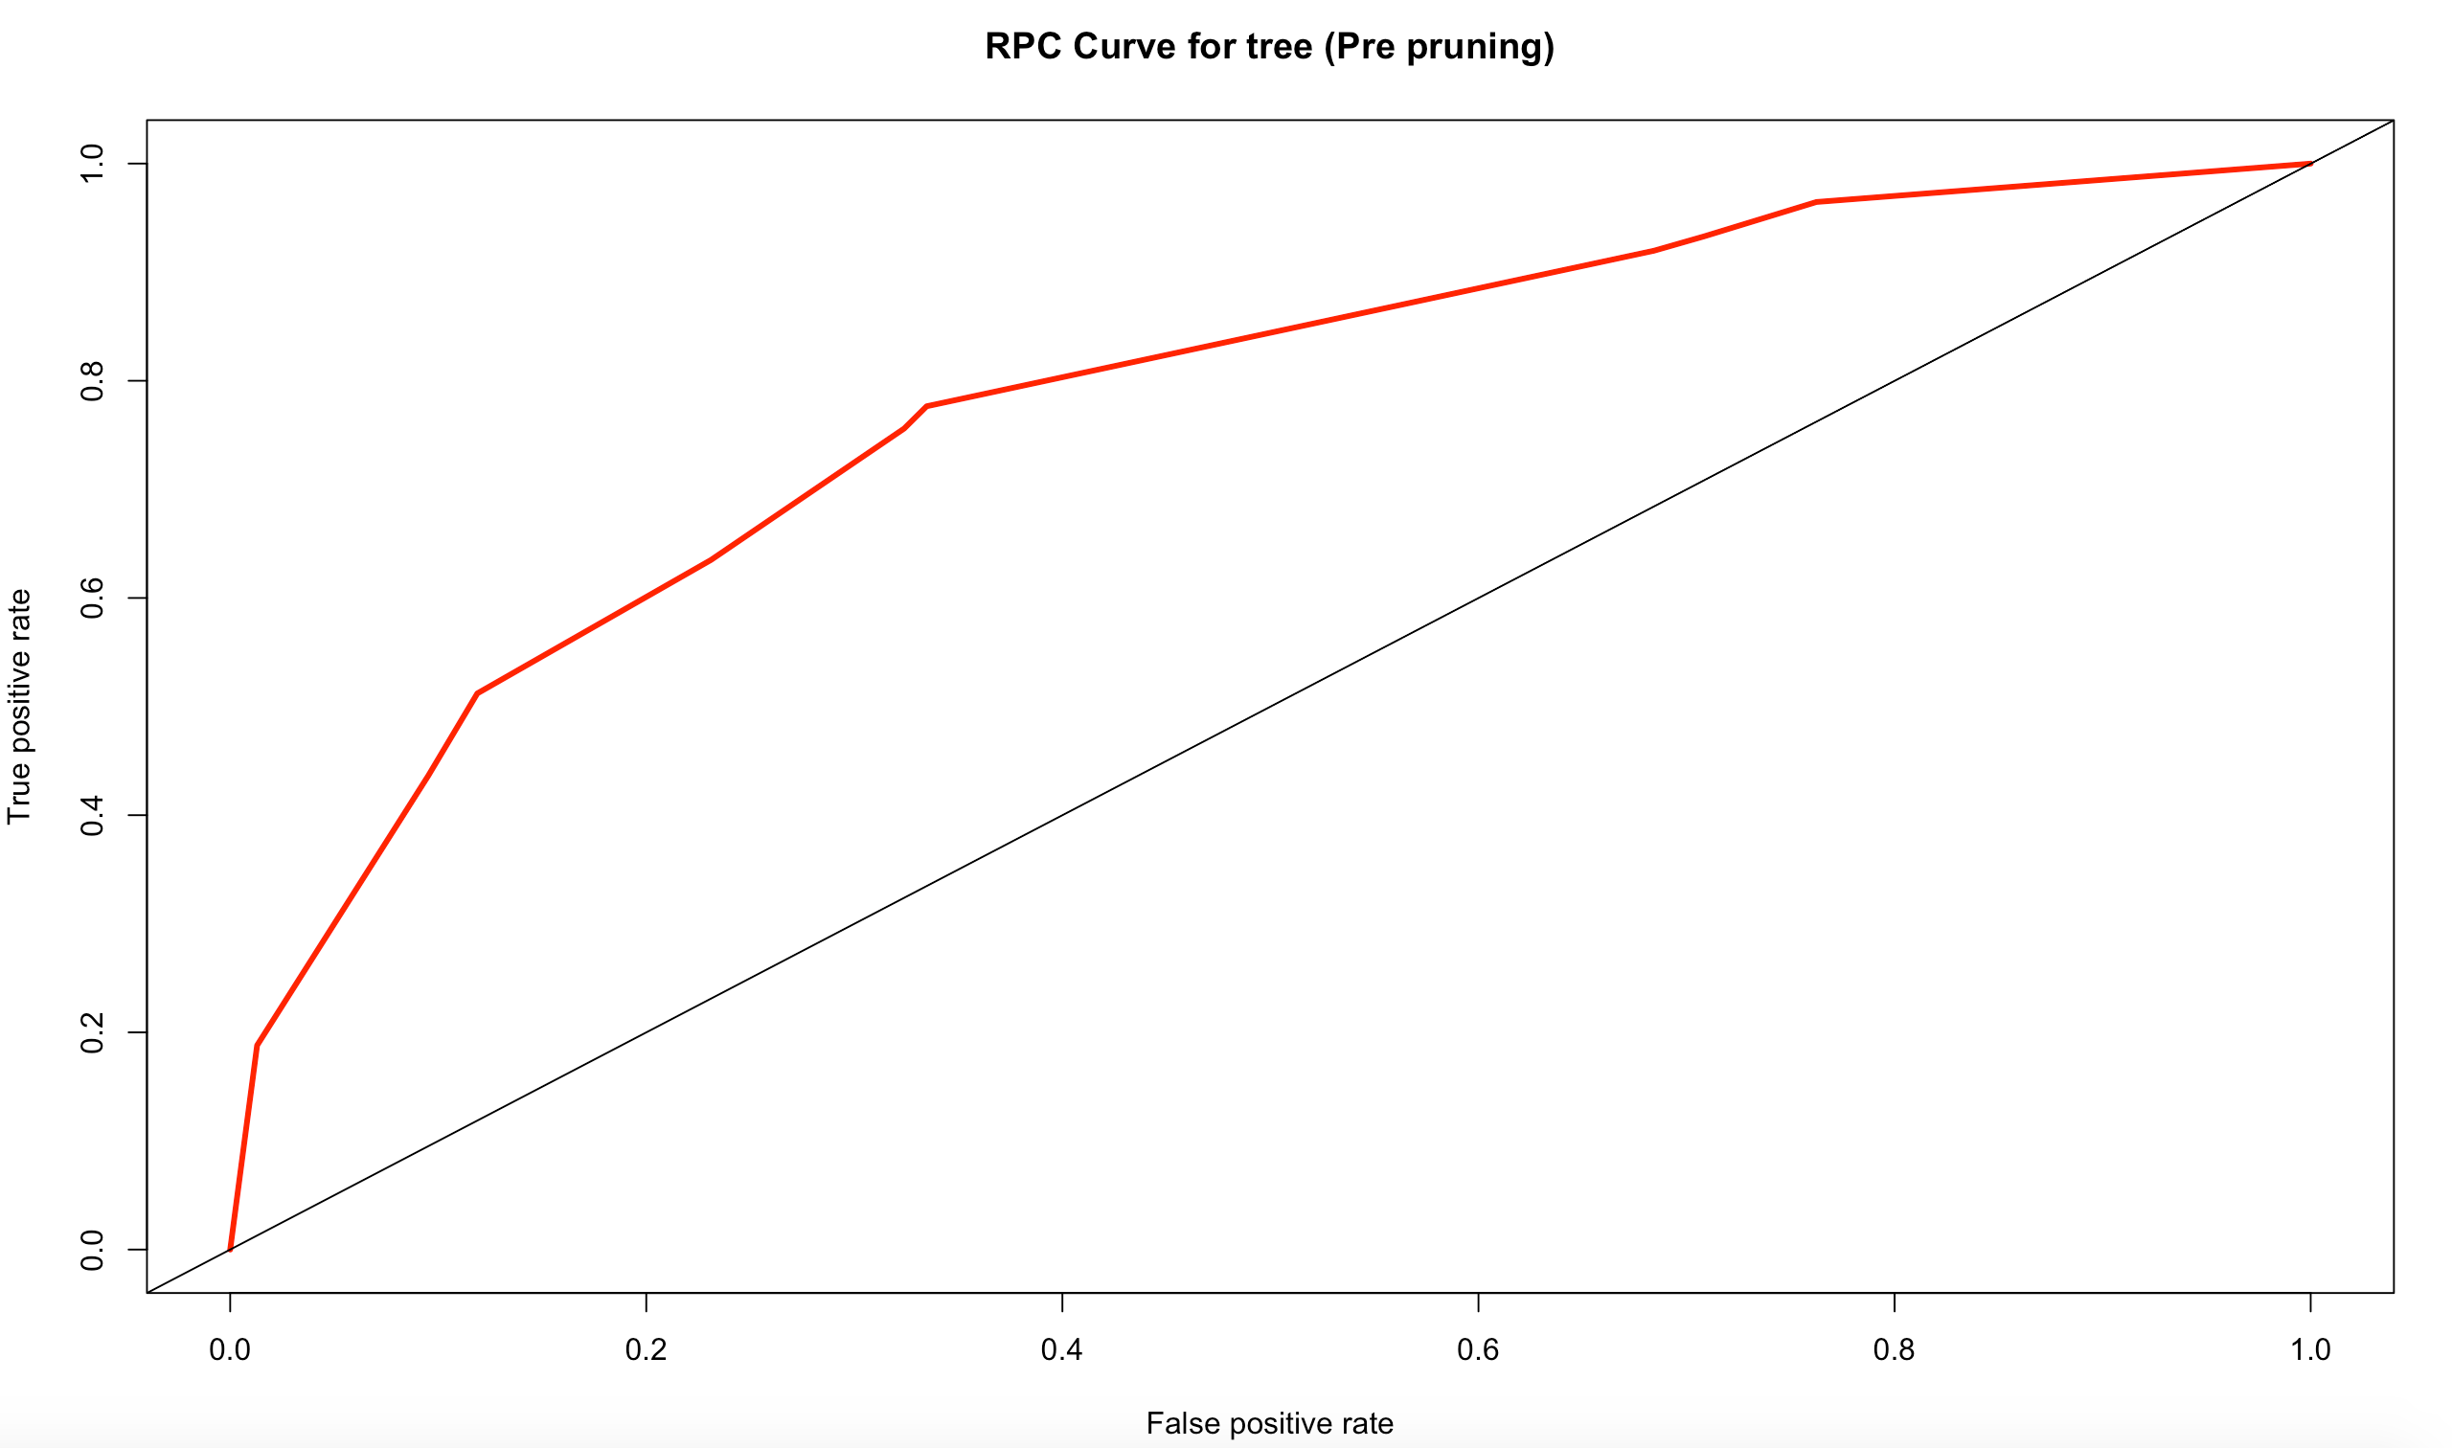
Decision tree (roc & auc)
AUC: 0.7787746

Slide 12
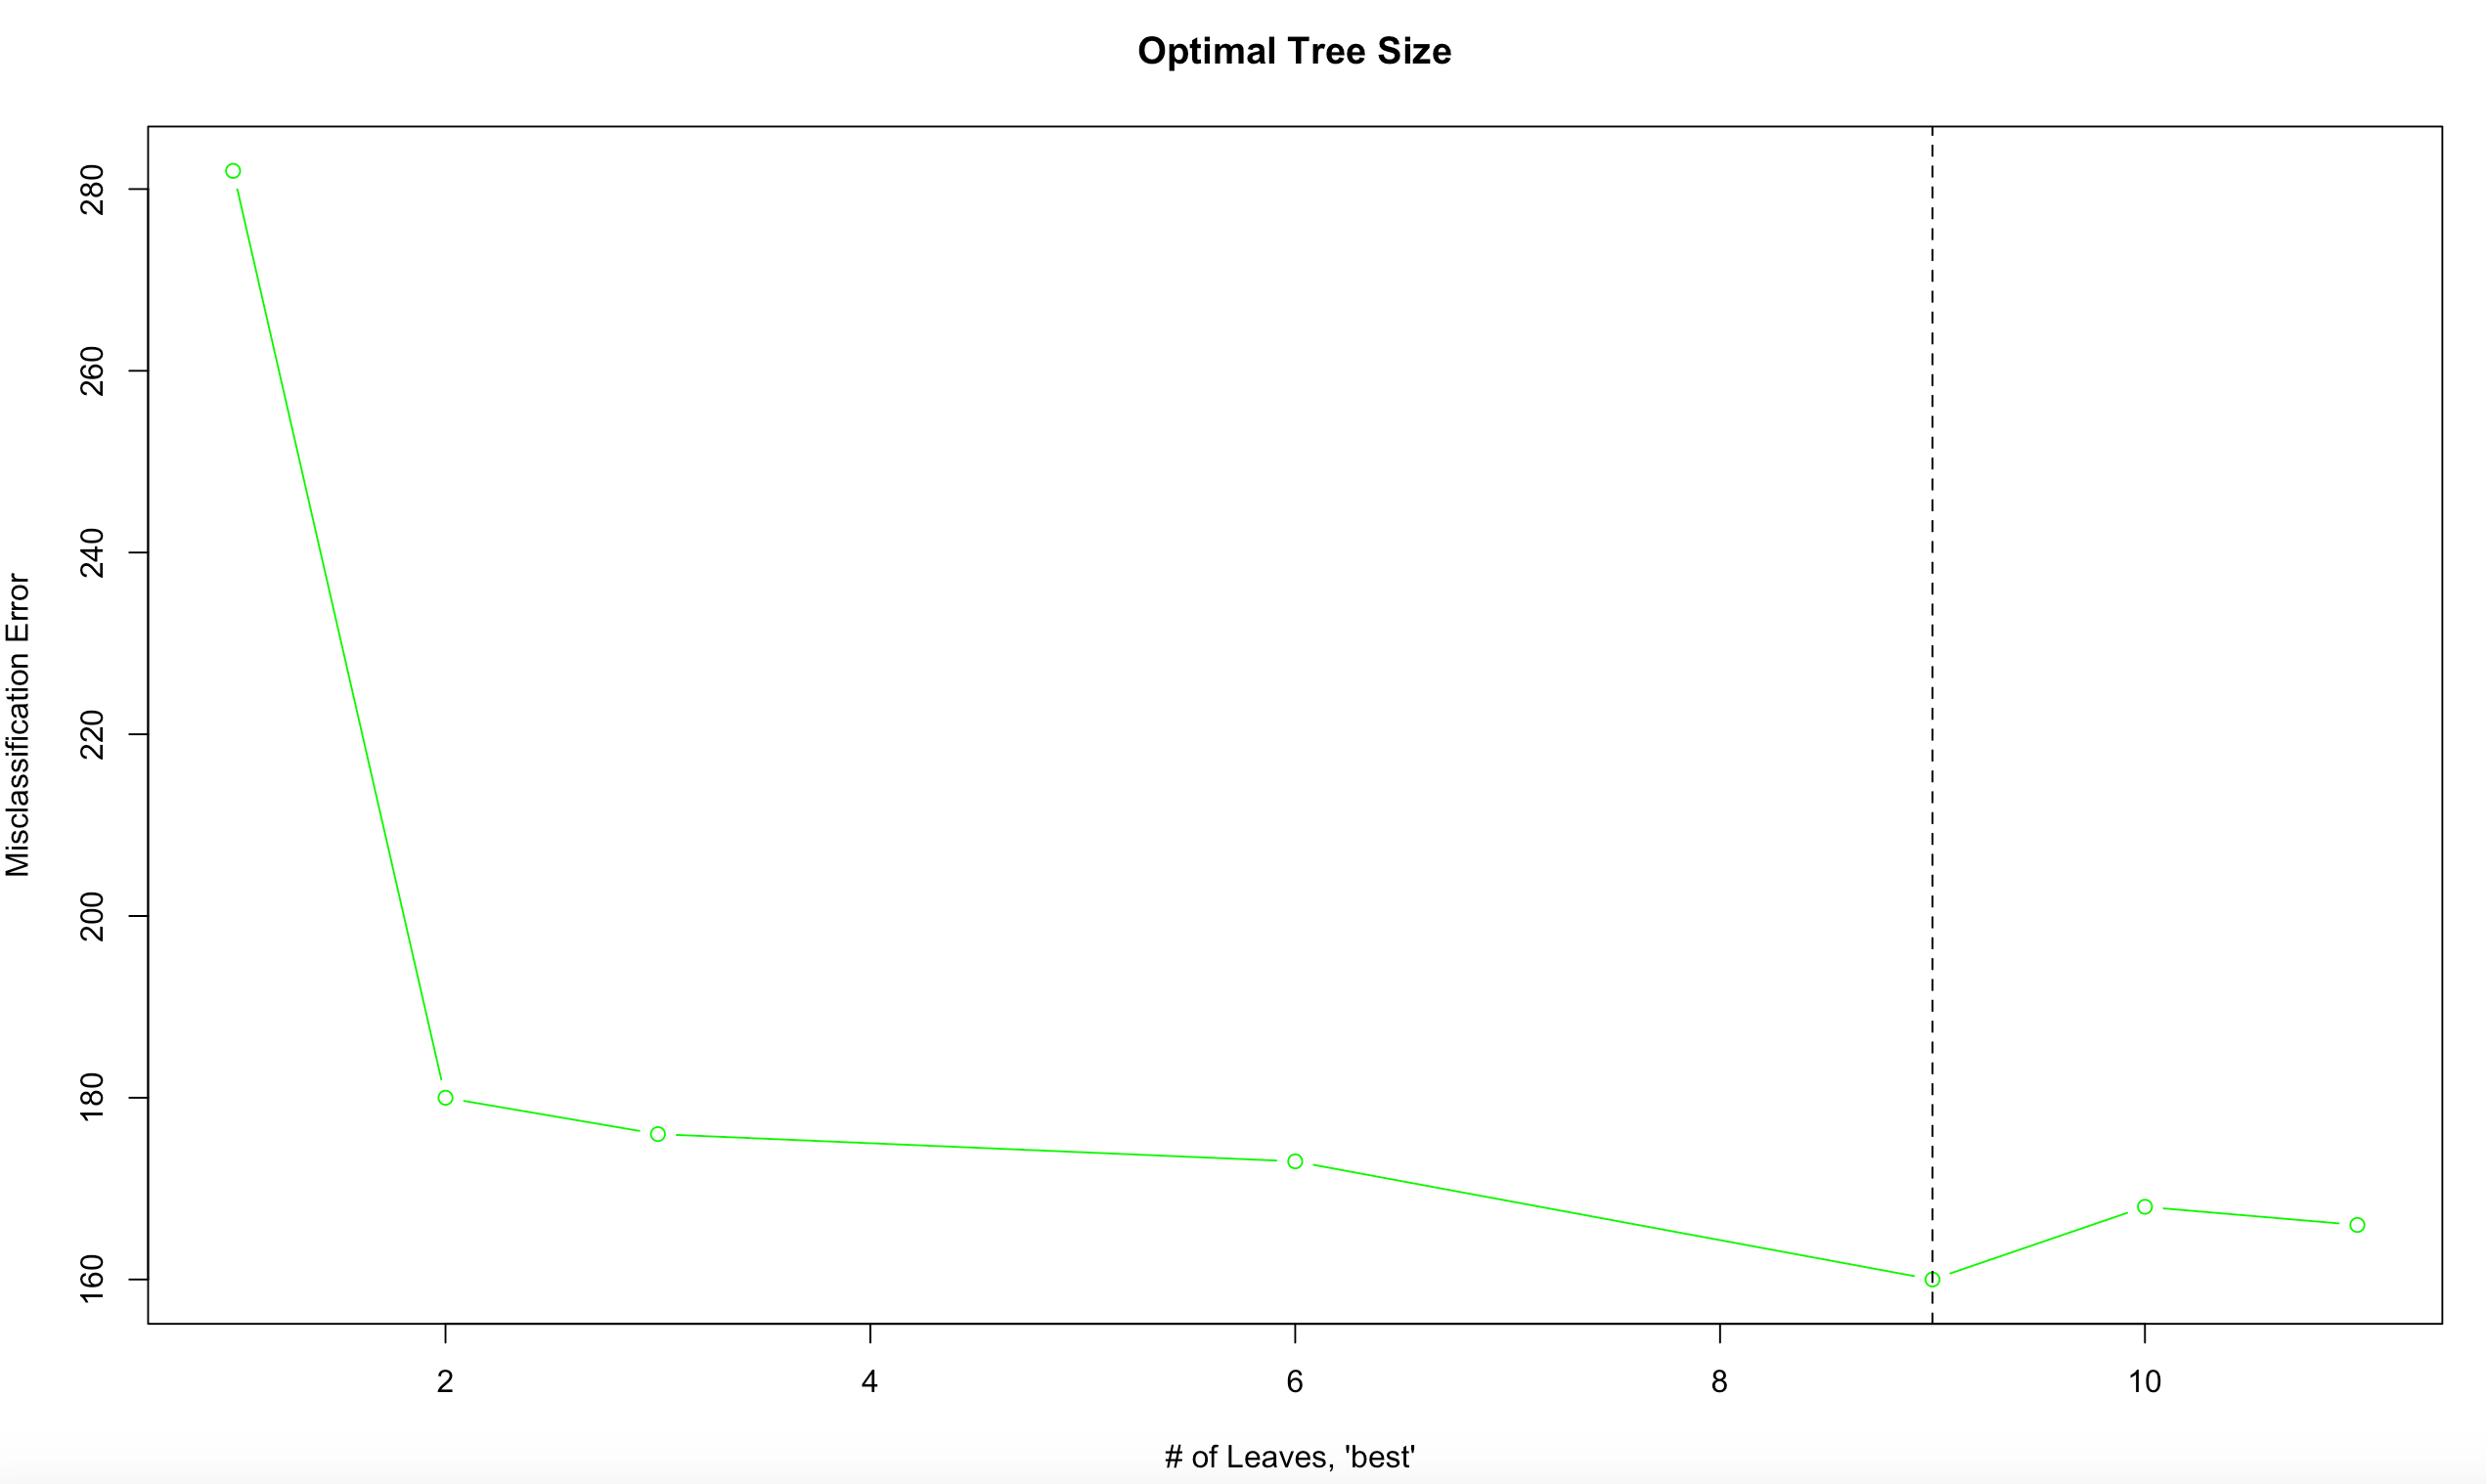
K-fold cross validation
Randomly separates the dataset into “folds” of a similar size
Will help find the optimal size for tree (# of nodes)
Tree should have 9 nodes

Slide 13
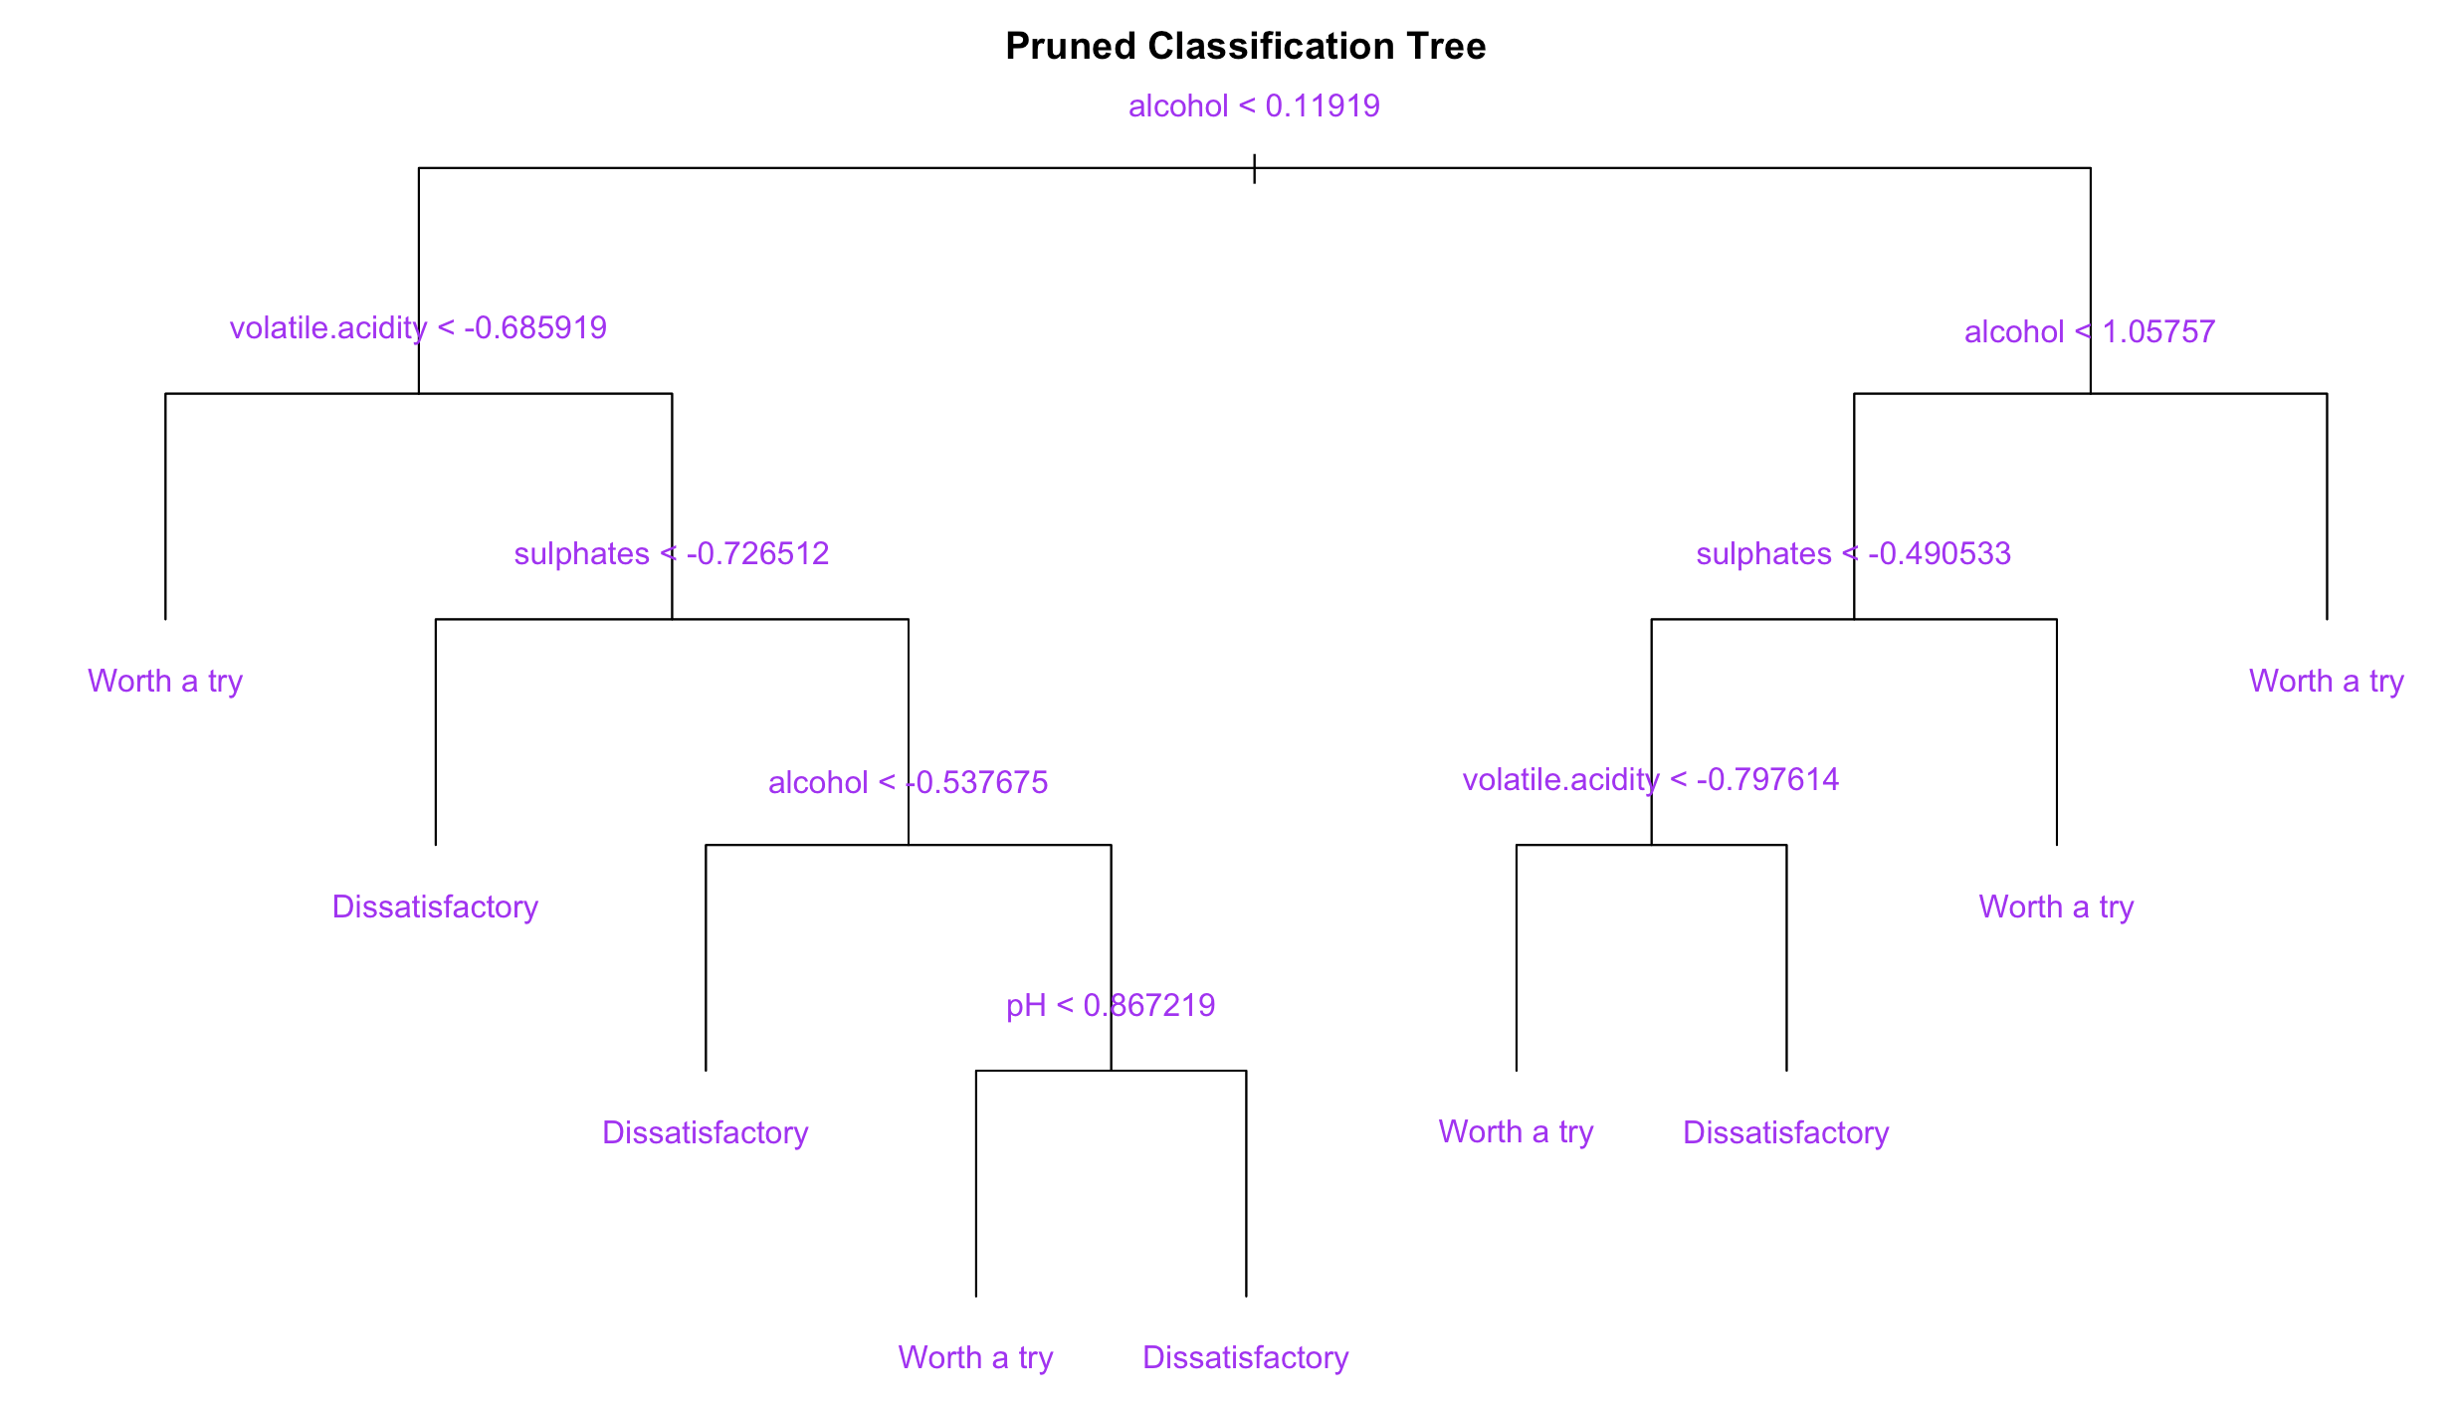
K-fold (cont’d)

Slide 14
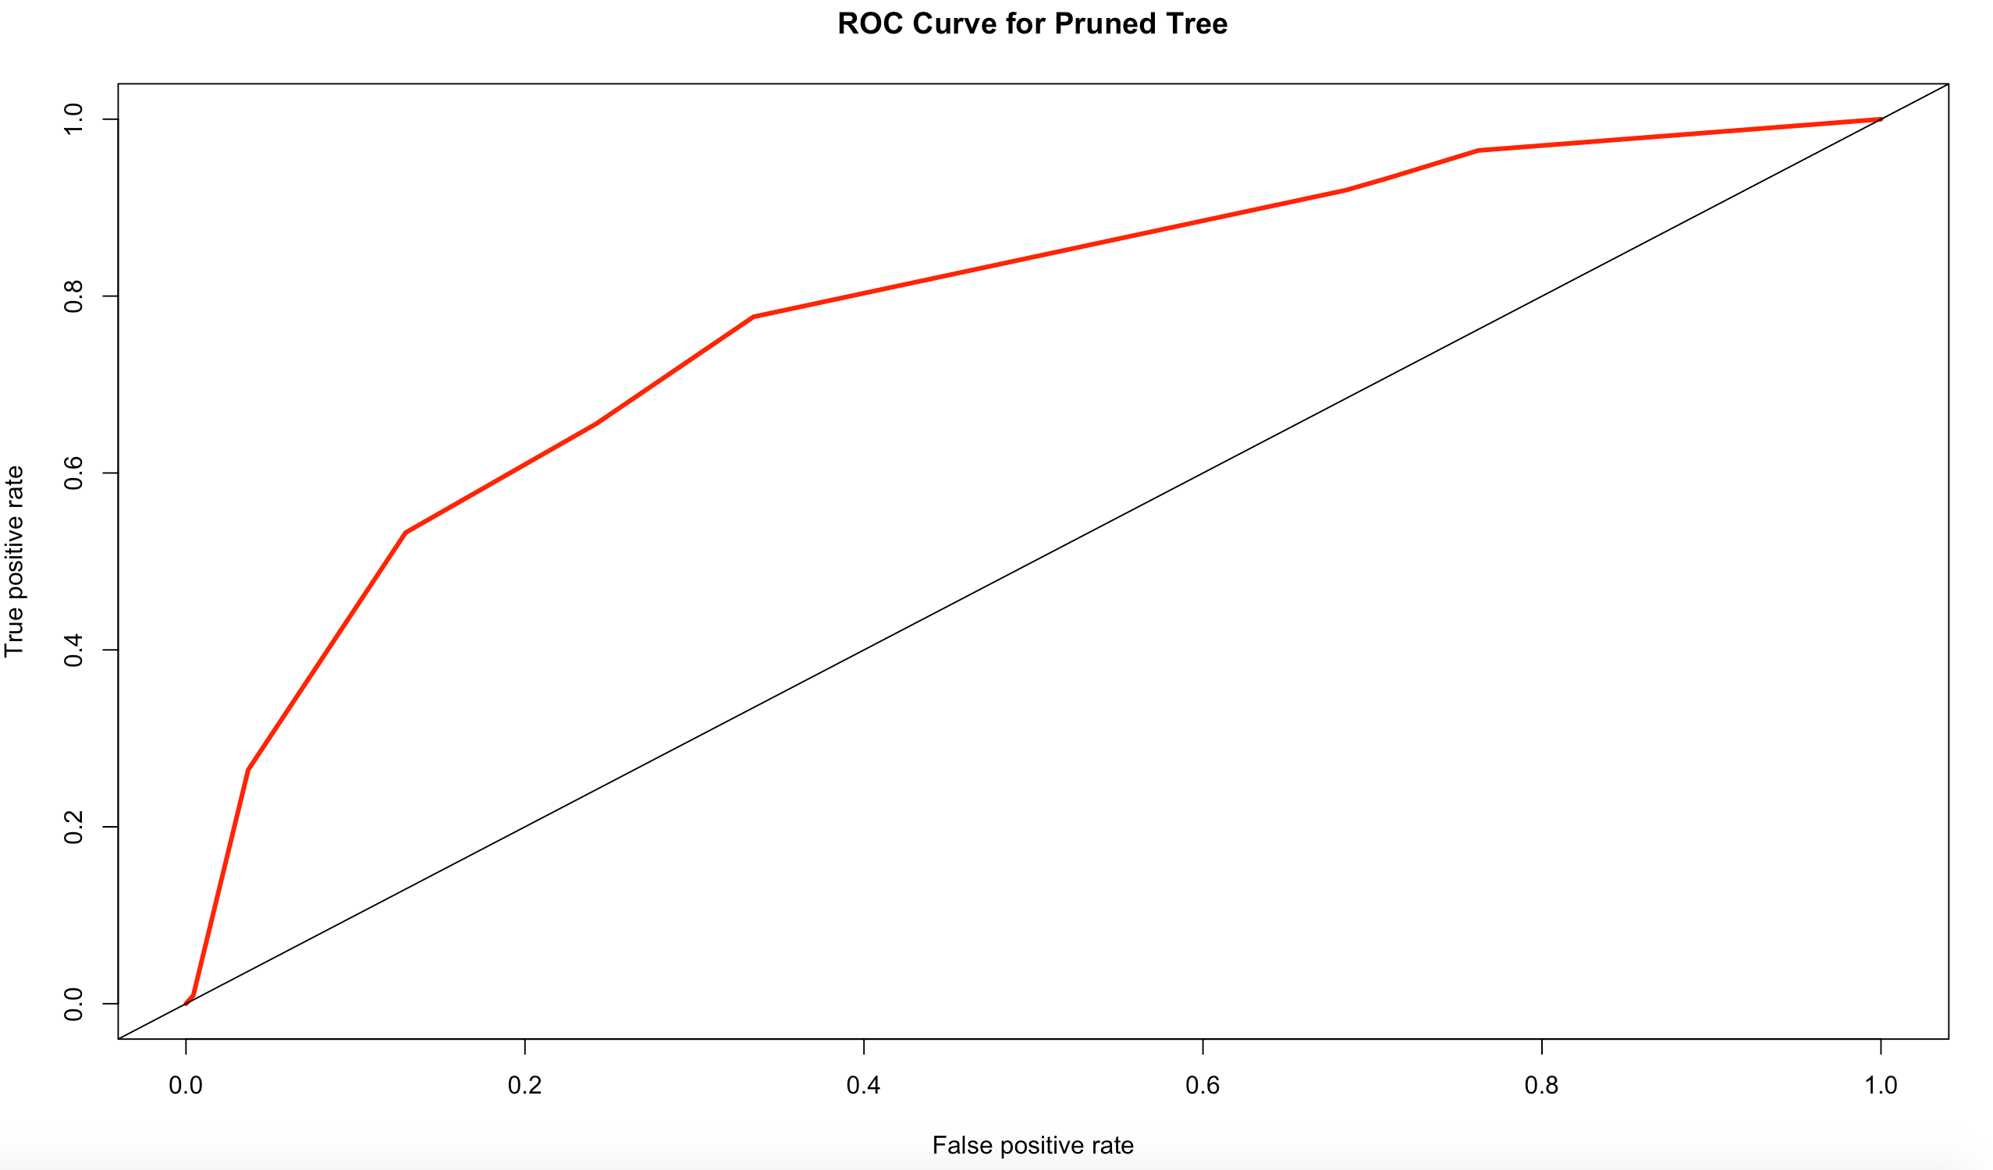
K-fold (cont’d)
Accuracy rate: 0.719
Error rate: 0.281
AUC: 0.7780888

Slide 15
Random forest
Similar to decision tree method – builds trees
Ensemble method that creates a variety of decision trees
Outputs the class that occurs most frequently among them

Slide 16
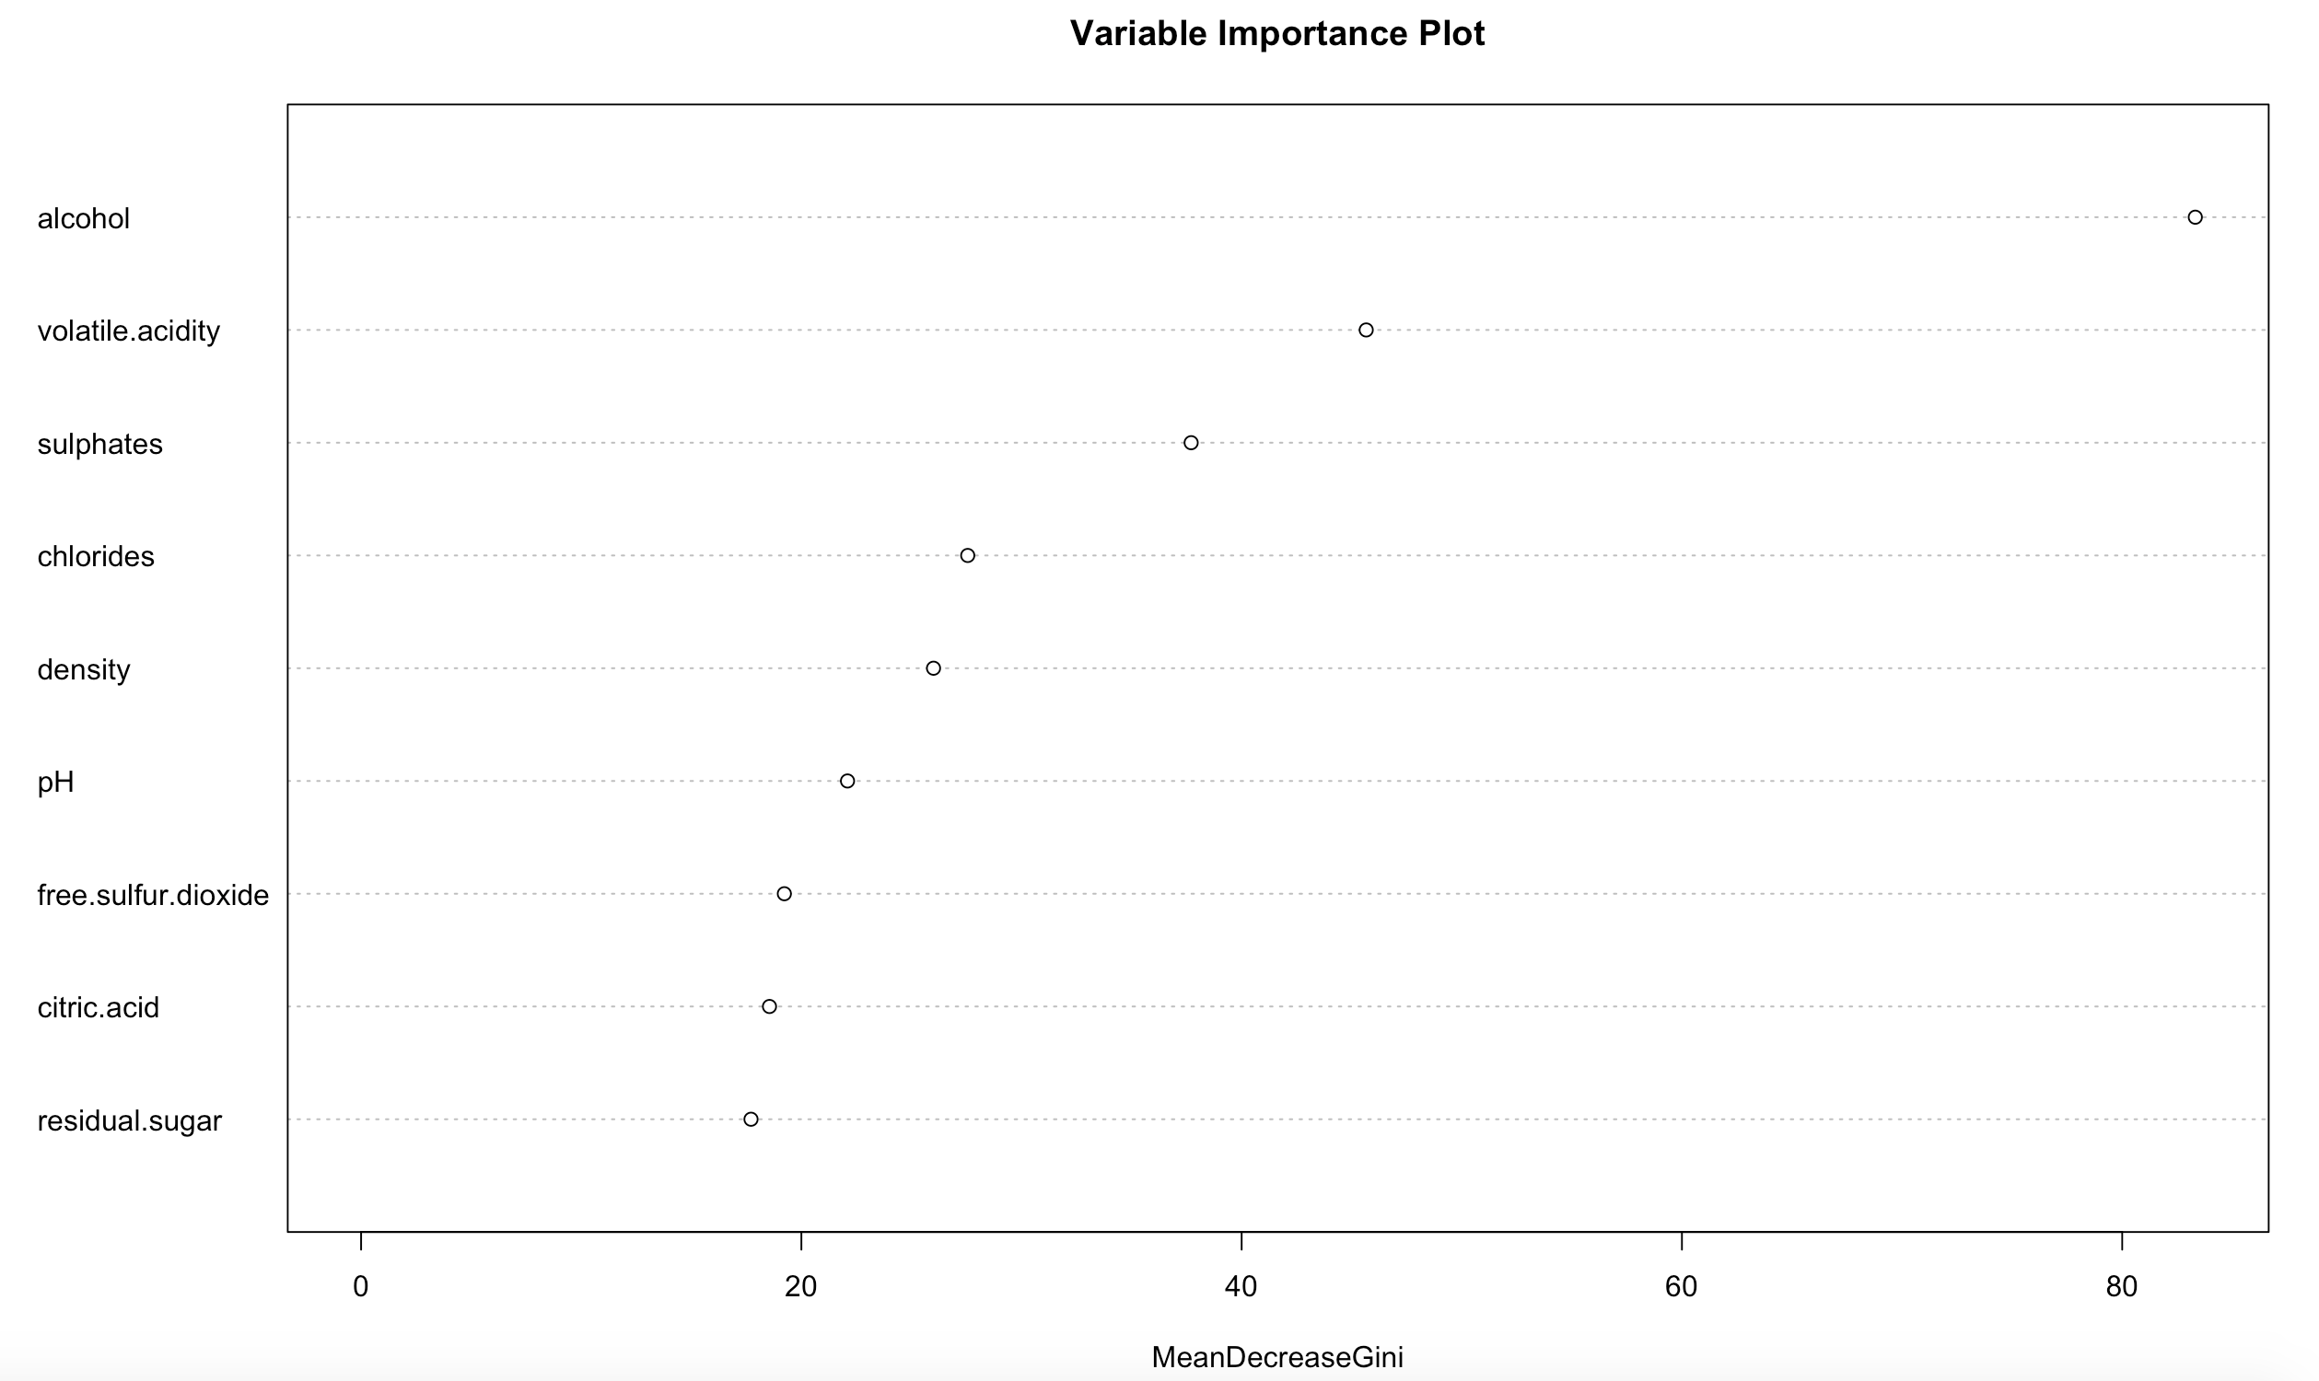
Random forest (cont’d)

Slide 17
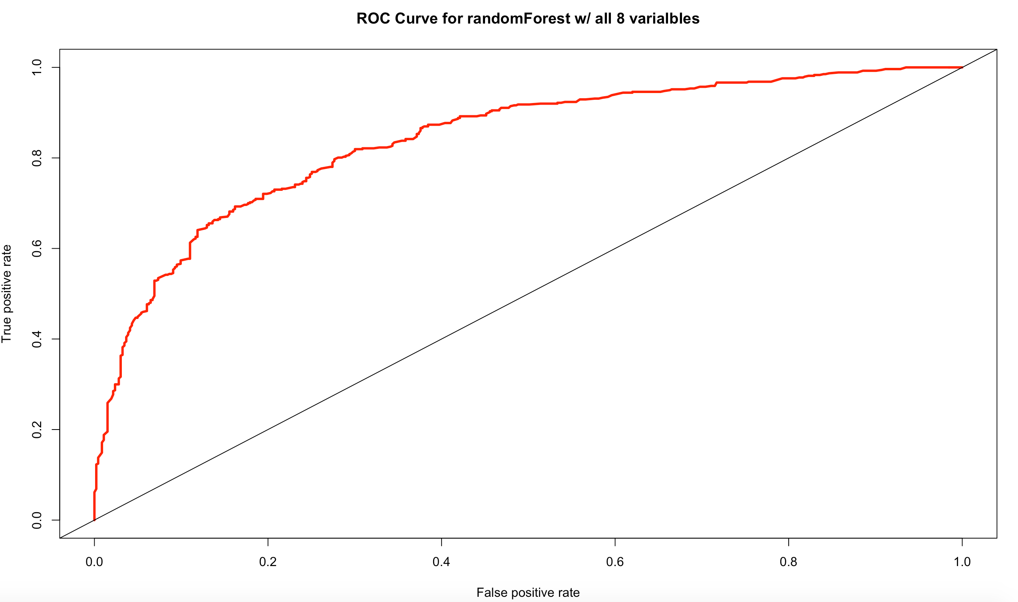
Random forest (full model)
Accuracy rate: 0.752
Error rate: 0.248
AUC: 0.8398651

Slide 18
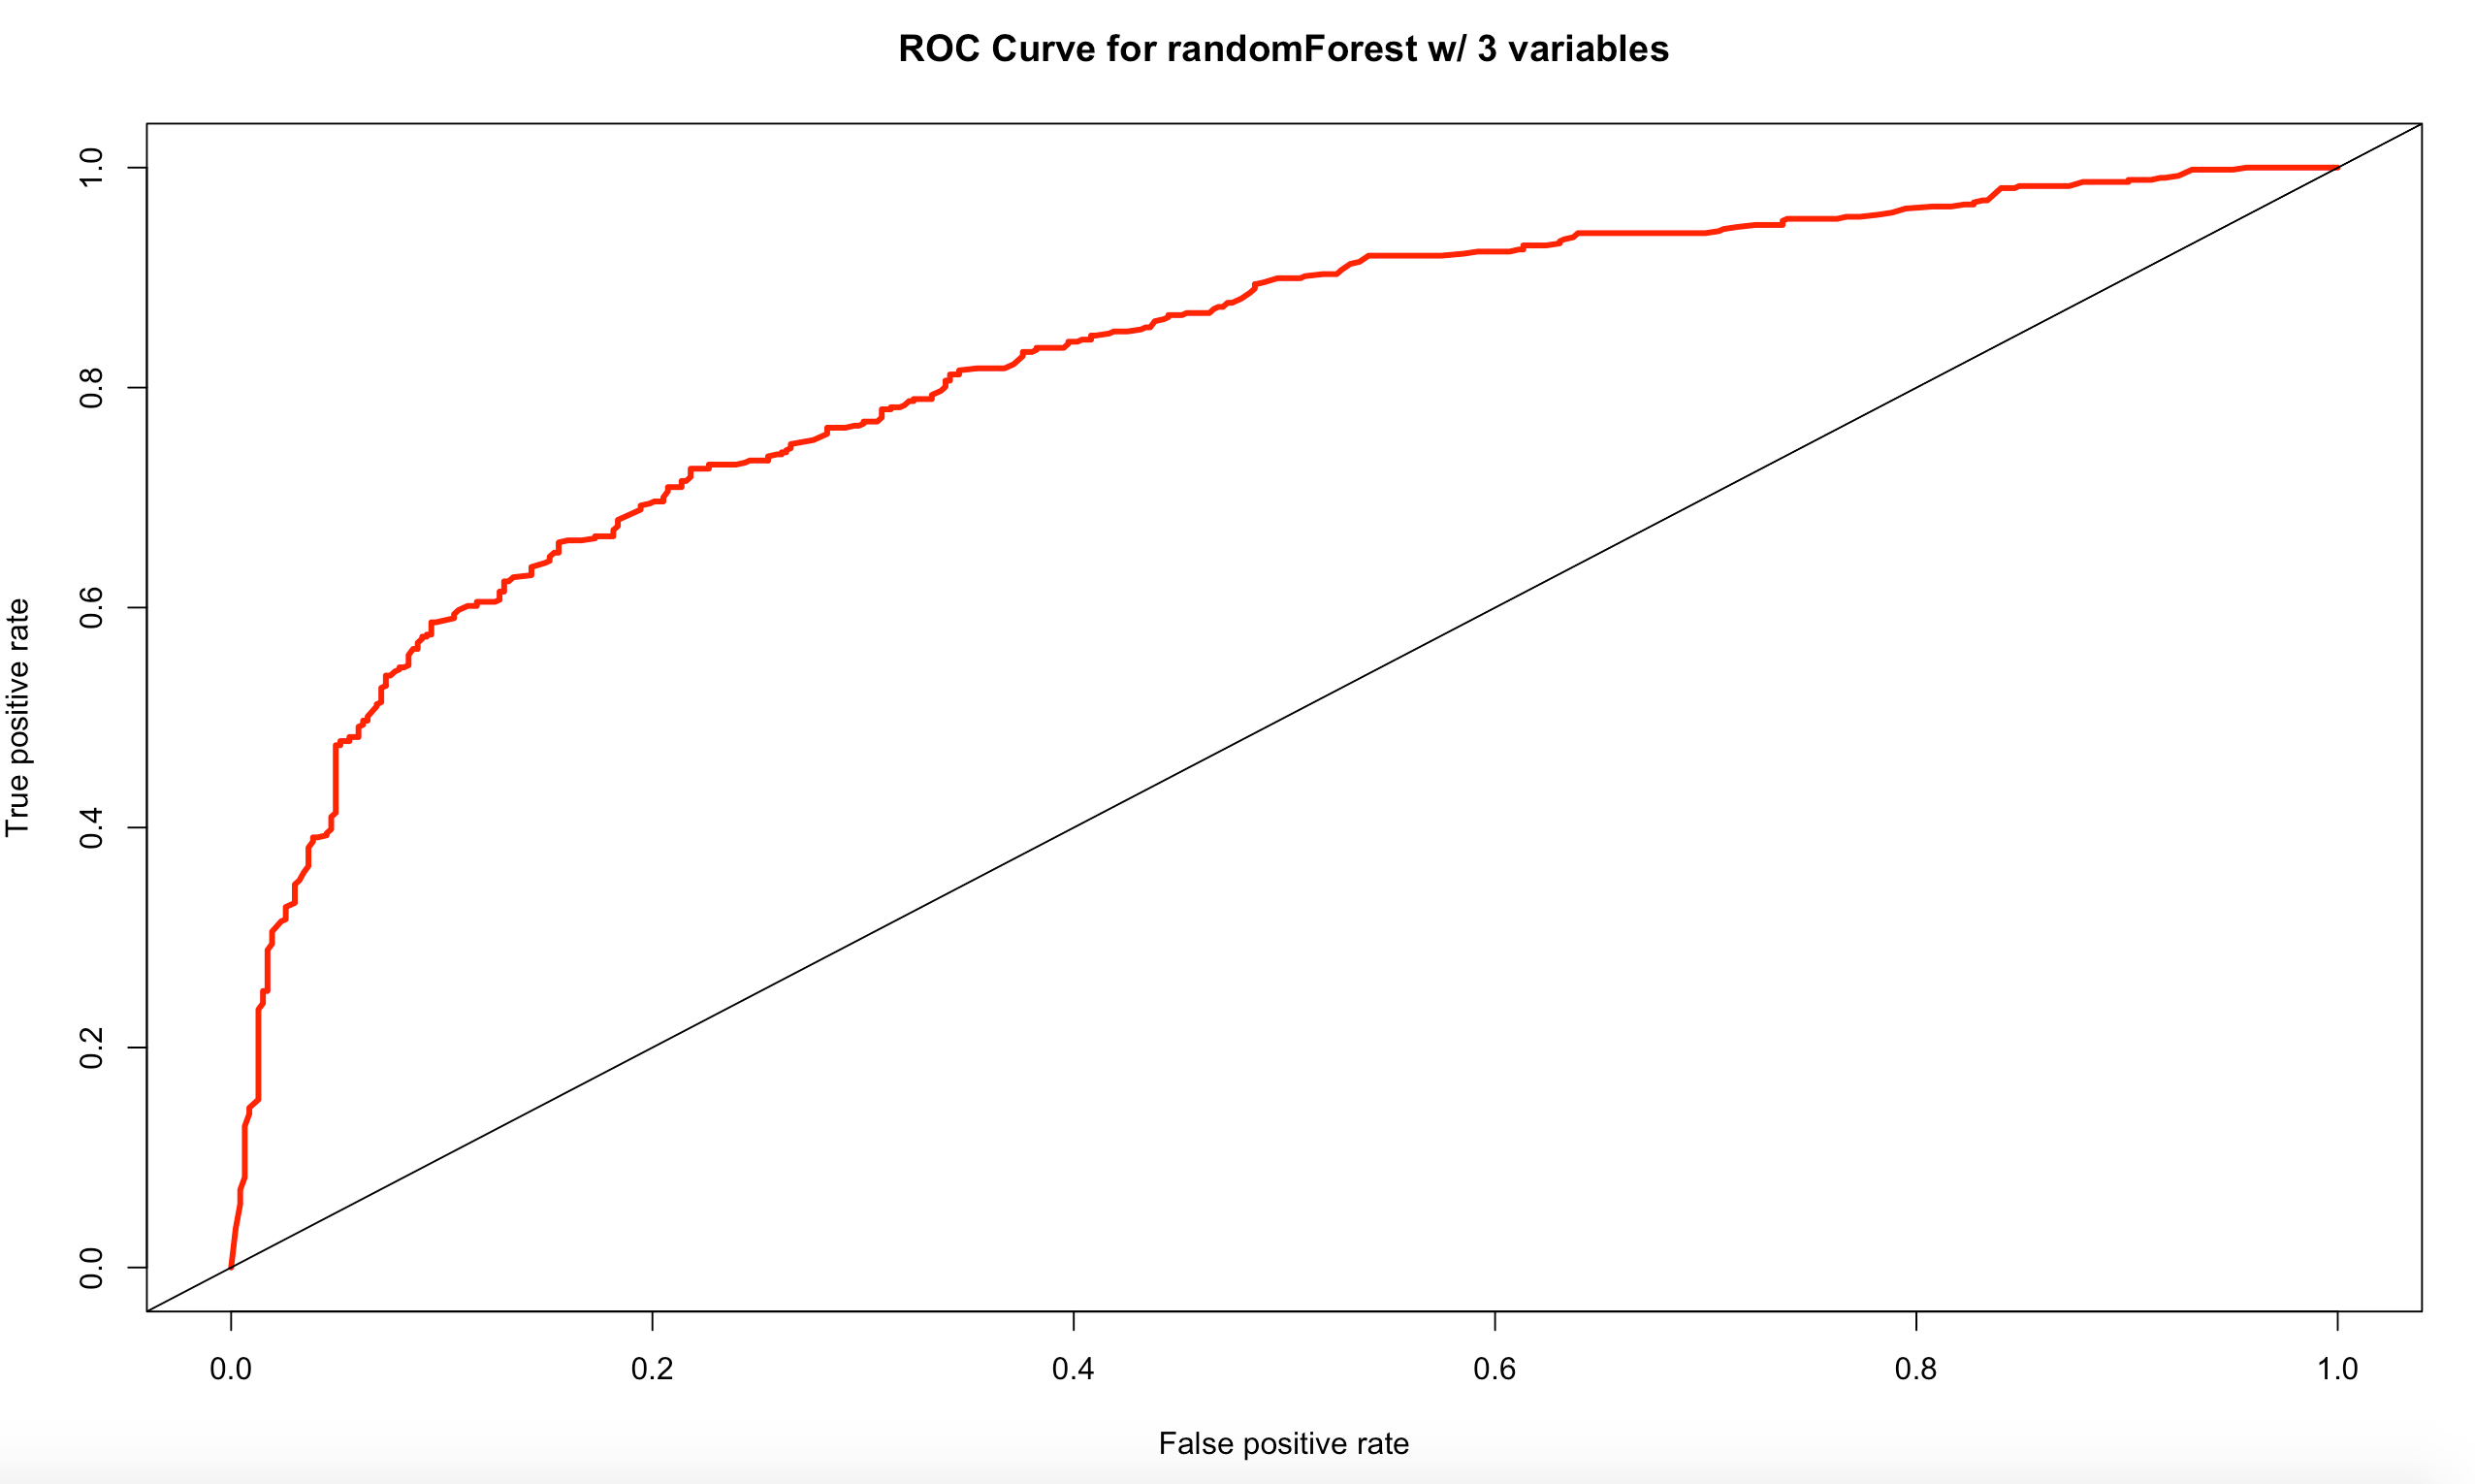
Random forest (simple model)
Accuracy rate: 0.743
Error rate: 0.257
AUC: 0.8235136

Slide 19
conclusion
Random Forest for the win!

